Slide 1
lecture4_linear_models

Slide 2
Linear models
Linear models are everywhere in statistics
Used for:
Comparison
Prediction

Slide 3
Linear models
$$y=a+b*x+error$$
$y$ = response, dependent variable
$a$ and $b$ are parameters
$x$ = predictor, independent variable
$error$ = normally distributed $N\left(0,σ^{2}\right)$

Slide 4
Linear models
Can be written in multiple ways:
$$y_{i}=a+b*x+ϵ_{I}$$
$$y_{i}∼N\left(a+b*x_{I},σ^{2}\right)$$
$$y∼N\left(a+b*x,σ^{2}\right)$$
$$y∼N\left(Xβ,σ^{2}I\right)$$
$$response∼a+predictor1+predictor2$$

Slide 5
Covariates, predictors, independent variables
Can be continuous
Can be categorical
Multiple covariates: $y∼a+b1*x1+b2*x2$
Interactions: $y∼a+b1*x1+b2*x2+b3*x1*x2$
Nonlinear: $\sqrt{y}∼a+b*x^{2}$

Slide 6
Linear models In R (1)
We can use the lm function in base R
mod = lm(response ~ predictor, data = mydata)
$a$ (the intercept) is assumed unless you specify -1 in the lm function.

Slide 7
Fitting a regression in R (1)
$$y∼x$$
$$y∼a+b*x$$
set.seed(123) n <- 40 x <- runif(n, 0, 20) y <- 0.2 + 0.3 * x + rnorm(n, mean = 0, sd = 0.5) mod <- lm(y ~ x)

Slide 8
Using summary(mod)
Call: lm(formula = y ~ x) Residuals: Min 1Q Median 3Q Max -0.81050 -0.28034 -0.02876 0.34065 1.02133 Coefficients: Estimate Std. Error t value Pr(>|t|) (Intercept) 0.1492 0.1537 0.97 0.338 x 0.3057 0.0121 25.27 <2e-16 *** --- Signif. codes: 0 '***' 0.001 '**' 0.01 '*' 0.05 '.' 0.1 ' ' 1 Residual standard error: 0.4485 on 38 degrees of freedom Multiple R-squared: 0.9438, Adjusted R-squared: 0.9424 F-statistic: 638.6 on 1 and 38 DF, p-value: < 2.2e-16

Slide 9
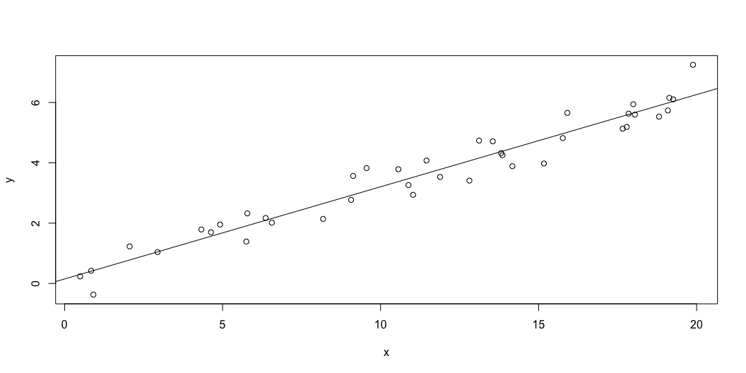
Displaying results (1)
plot(x, y) abline(mod)

Slide 10
Linear models in R (2)
We can also specify out own function
lm_fun <- function(pars, y, x){ alpha <- pars[1] beta <- pars[2] sigma <- exp(pars[3]) # Exp to keep positive nll = -sum(dnorm(y, alpha + beta * x, sigma, log = TRUE)) return(nll) } fit <- optim(par = c(0,0,0), lm_fun, y = y, x = x, hessian = TRUE) fit$par
[1] 0.1491114 0.3057342 -0.8273512

Slide 11
Linear models in R (2)
Smart way using model matrix
lm_fun <- function(pars, y, x){ beta <- pars[1:ncol(x)] sigma <- exp(pars[ncol(x) + 1]) # Exp to keep positive nll = -sum(dnorm(y, x %*% beta, sigma, log = TRUE)) return(nll) } x_mat <- model.matrix(formula(~ 1 + x)) fit <- optim(par = c(0,0,0), lm_fun, y = y, x = x_mat, hessian = TRUE) fit$par
[1] 0.1491114 0.3057342 -0.8273512

Slide 12
Summary (2)
We can get the variance-covariance of the parameters by inverting the hessian
Hessian is the matrix of second derivatives of the log-likelihood
vcov <- solve(fit$hessian) se <- sqrt(diag(vcov)) se
[1] 0.14988071 0.01179454 0.11183044

Slide 13
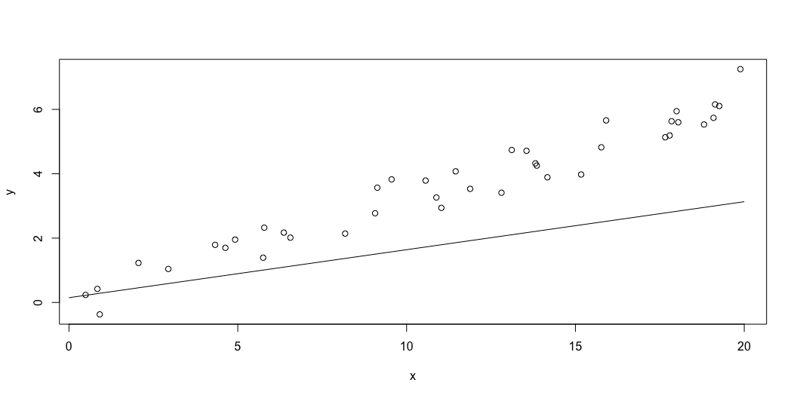
Displaying results (2)
plot(x, y) curve(fit$par[1] + x * fit$par[1], from = 0, to = 20, add = TRUE)

Slide 14
Linear models in RTMB
library(RTMB) f <- function(parms) { y <- data$y x <- data$x a <- parms$a b <- parms$b logSigma <- parms$logSigma ADREPORT(exp(2*logSigma)); nll = -sum(dnorm(y, a+b*x, exp(logSigma), TRUE)) nll }

Slide 15
data <- list(y = y, x = x) parameters <- list(a=0, b=0, logSigma=0) obj <- MakeADFun(f, parameters, silent = TRUE) obj$hessian <- TRUE opt <- do.call("optim", obj) # opt # opt$hessian ## <-- FD hessian from optim # obj$he() ## <-- Analytical hessian rep <- sdreport(obj) summary(rep)
Estimate Std. Error a 0.1491907 0.14984438 b 0.3057308 0.01179168 logSigma -0.8275936 0.11180337 exp(2 * logSigma) 0.1910563 0.04272147

Slide 16
Comparison of two groups (1)
$$y∼group$$
$$y∼a+b*group$$
group <- rep(c(0, 1), each = n/2) y <- 0.2 + 2 * group + rnorm(n, mean = 0, sd = 0.5) mod <- lm(y ~ as.factor(group))

Slide 17
summary(mod)
Call: lm(formula = y ~ as.factor(group)) Residuals: Min 1Q Median 3Q Max -1.09463 -0.29969 -0.01557 0.29035 1.08500 Coefficients: Estimate Std. Error t value Pr(>|t|) (Intercept) 0.1400 0.1011 1.386 0.174 as.factor(group)1 2.2475 0.1429 15.725 <2e-16 *** --- Signif. codes: 0 '***' 0.001 '**' 0.01 '*' 0.05 '.' 0.1 ' ' 1 Residual standard error: 0.452 on 38 degrees of freedom Multiple R-squared: 0.8668, Adjusted R-squared: 0.8633 F-statistic: 247.3 on 1 and 38 DF, p-value: < 2.2e-16

Slide 18
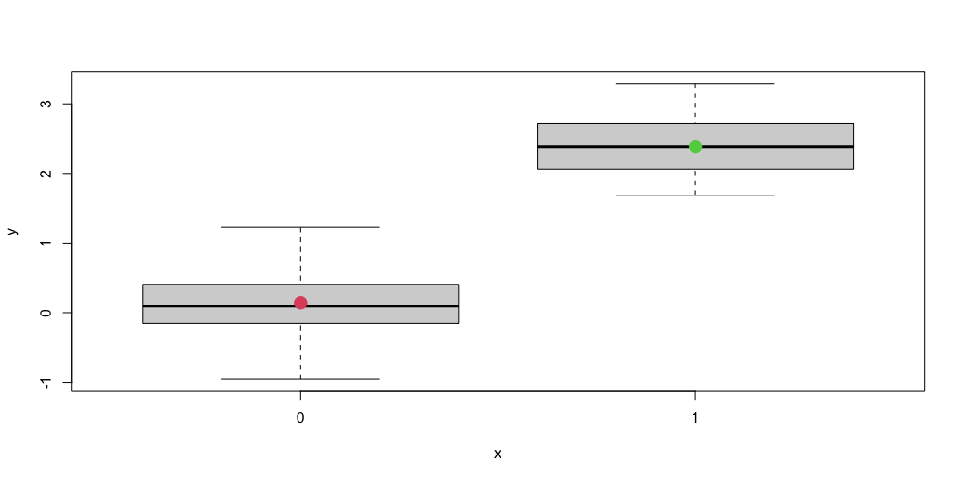
Comparison of two groups (2)
plot(as.factor(group), y) # Model mean_val <- c(mod$coefficients[1], mod$coefficients[1]+mod$coefficients[2]) points(as.factor(c(0,1)), mean_val, pch = 16, col = c(2,3), cex = 2)

Slide 19
Multiple predictors (1)
One continuous and one categorical
$$y∼x1+group$$
$$y∼a+b1*x1+b2*group$$
y <- 0.2 + 0.3 * x + 2 * group + rnorm(n, mean = 0, sd = 0.5) mod <- lm(y ~ x + as.factor(group))

Slide 20
summary(mod)
Call: lm(formula = y ~ x + as.factor(group)) Residuals: Min 1Q Median 3Q Max -1.01674 -0.25908 0.00055 0.26584 0.96937 Coefficients: Estimate Std. Error t value Pr(>|t|) (Intercept) 0.02958 0.17228 0.172 0.865 x 0.29916 0.01250 23.932 <2e-16 *** as.factor(group)1 2.16095 0.14653 14.747 <2e-16 *** --- Signif. codes: 0 '***' 0.001 '**' 0.01 '*' 0.05 '.' 0.1 ' ' 1 Residual standard error: 0.4629 on 37 degrees of freedom Multiple R-squared: 0.957, Adjusted R-squared: 0.9547 F-statistic: 411.5 on 2 and 37 DF, p-value: < 2.2e-16

Slide 21
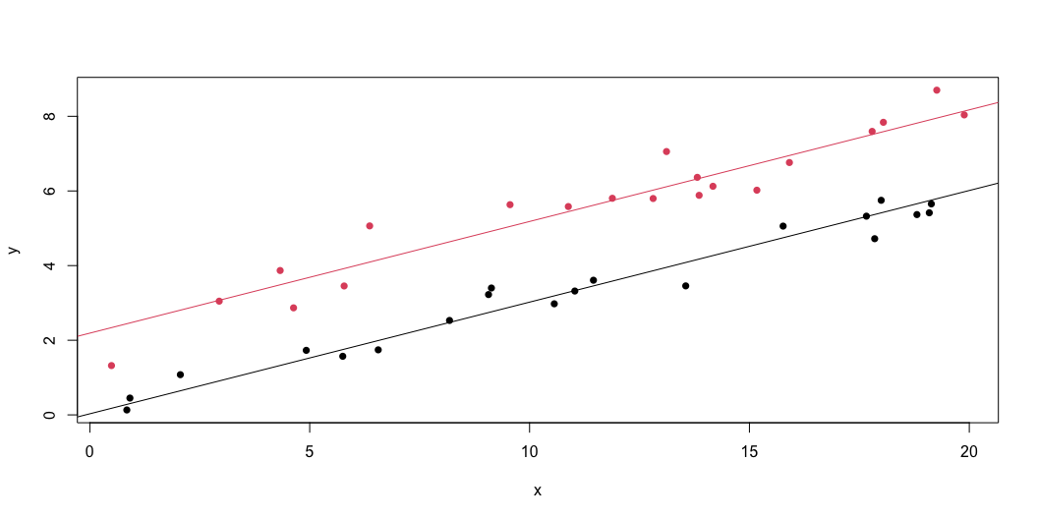
Multiple predictors (2)
plot(x, y, col = 1 + group, pch = 16) # Fitted model abline(a = mod$coefficients[1], b = mod$coefficients[2]) abline(a = mod$coefficients[1] + mod$coefficients[3], b = mod$coefficients[2], col = 2)

Slide 22
Interaction (1)
One continuous and one categorical
For example: growth in high vs low acidity
$$y∼a+b1*x1+b2*x1*group$$
y <- 0.2 + 0.3 * x + x * group + rnorm(n, mean = 0, sd = 0.5) mod <- lm(y ~ x * as.factor(group)) mod <- lm(y ~ x + as.factor(group) + x * as.factor(group))

Slide 23
summary(mod) and no group effect!
Call: lm(formula = y ~ x + as.factor(group) + x * as.factor(group)) Residuals: Min 1Q Median 3Q Max -0.75454 -0.36047 -0.04052 0.32799 1.26856 Coefficients: Estimate Std. Error t value Pr(>|t|) (Intercept) 0.20519 0.24089 0.852 0.400 x 0.29166 0.01912 15.253 <2e-16 *** as.factor(group)1 -0.29262 0.36035 -0.812 0.422 x:as.factor(group)1 1.04049 0.02833 36.721 <2e-16 *** --- Signif. codes: 0 '***' 0.001 '**' 0.01 '*' 0.05 '.' 0.1 ' ' 1 Residual standard error: 0.5226 on 36 degrees of freedom Multiple R-squared: 0.9962, Adjusted R-squared: 0.9959 F-statistic: 3148 on 3 and 36 DF, p-value: < 2.2e-16

Slide 24
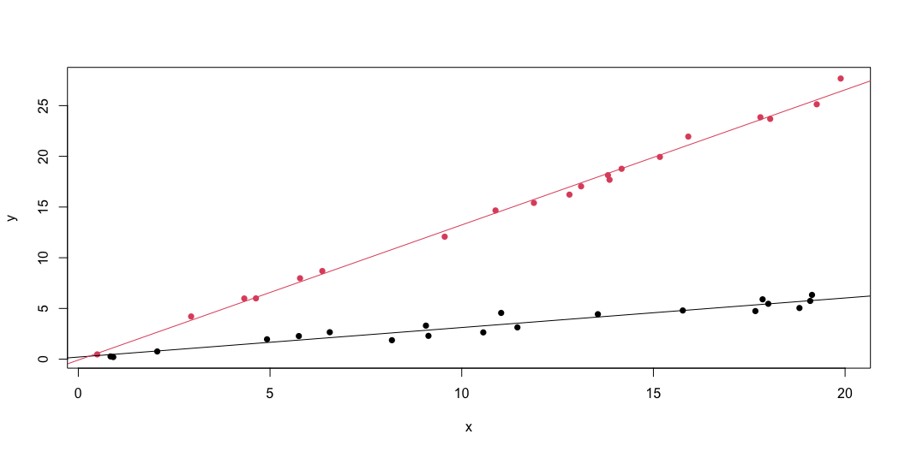
Interaction (2)
plot(x, y, col = 1 + group, pch = 16) # Fitted model abline(a = mod$coefficients[1], b = mod$coefficients[2]) abline(a = mod$coefficients[1]+mod$coefficients[3], b = mod$coefficients[2] + +mod$coefficients[4], col = 2)

Slide 25
Interaction (3)
library(palmerpenguins) data(package = 'palmerpenguins')

Slide 26
Multiple continuous predictors (1)
$$y∼x1+x2$$
$$y∼a+b1*x1+b2*x2$$
x1 <- runif(n, 0, 20) x2 <- runif(n, 5, 10) y <- 0.2 + 0.3 * x1 + 2 * x2 + rnorm(n, mean = 0, sd = 0.5) mod <- lm(y ~ x1 + x2)

Slide 27
summary(mod)
Call: lm(formula = y ~ x1 + x2) Residuals: Min 1Q Median 3Q Max -0.70245 -0.35957 -0.09731 0.23879 1.06434 Coefficients: Estimate Std. Error t value Pr(>|t|) (Intercept) 0.08303 0.38064 0.218 0.829 x1 0.28632 0.01188 24.097 <2e-16 *** x2 2.03122 0.05052 40.203 <2e-16 *** --- Signif. codes: 0 '***' 0.001 '**' 0.01 '*' 0.05 '.' 0.1 ' ' 1 Residual standard error: 0.4445 on 37 degrees of freedom Multiple R-squared: 0.9857, Adjusted R-squared: 0.9849 F-statistic: 1275 on 2 and 37 DF, p-value: < 2.2e-16

Slide 28
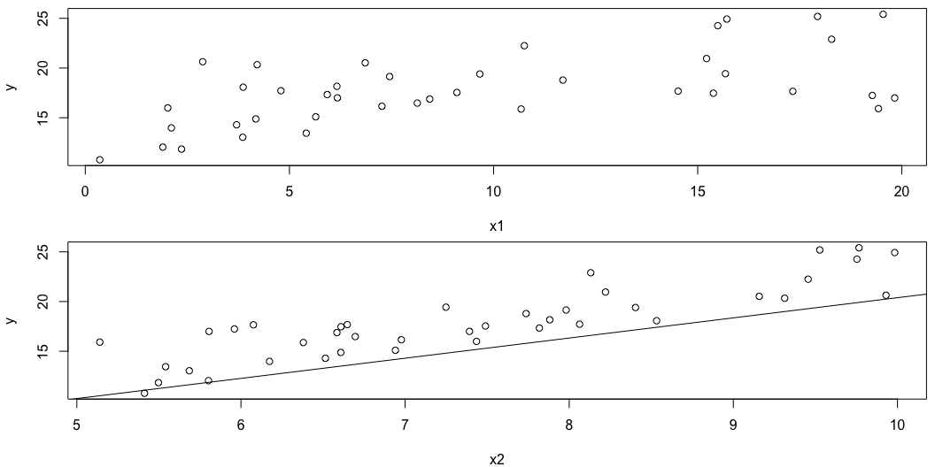
Multiple continuous predictors (2)
par(mfrow = c(2, 1), mar = c(4, 4, 0.5, 0.5)) plot(x1, y) abline(a = mod$coefficients[1], b = mod$coefficients[2]) plot(x2, y) abline(a = mod$coefficients[1], b = mod$coefficients[3])

Slide 29
Multiple continuous predictors (3)
What went wrong?

Slide 30
Multiple continuous predictors (4)
Have to fix covariates at arbitrary values!

Slide 31
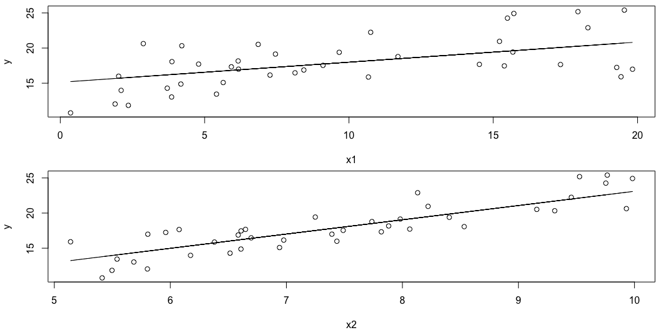
Multiple continuous predictors (4)
par(mfrow = c(2, 1), mar = c(4, 4, 0.5, 0.5)) plot(x1, y) pred1 <- data.frame(x1 = x1, x2 = mean(x2)) pred1$y = predict(mod, pred1) lines(pred1$x1, pred1$y) plot(x2, y) pred2 <- data.frame(x1 = mean(x1), x2 = x2) pred2$y = predict(mod, pred2) lines(pred2$x2, pred2$y)

Slide 32
Multiple predictors overview
It can be hard to visualize models with multiple predictors!
Packages like marginaleffects can help

Slide 33
Where models can fail
Collinearity (correlation between covariates)
x1 <- runif(n, 0, 20) rho = 1 x2 <- 2 + rho * x1 + (1-rho) * runif(n, 0, 20) y <- 0.2 + 0.3 * x1 + 2 * x2 + rnorm(n, mean = 0, sd = 0.5) mod <- lm(y ~ x1 + x2)

Slide 34
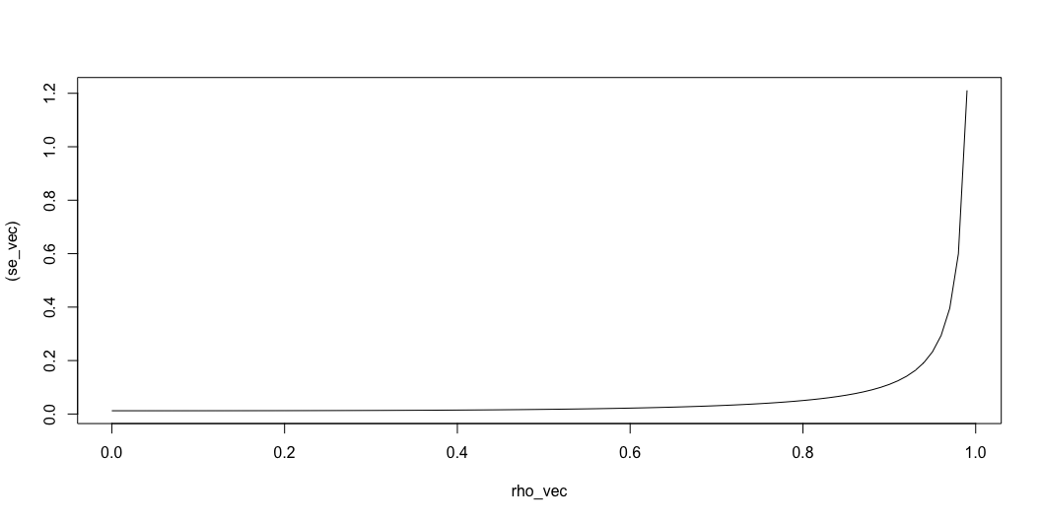
What happens to SE as rho -> 0

Slide 35
Lack of independence
Collinearity (correlation between covariates)
library(MASS) x1 <- runif(1000, -1, 1) Sigma = diag(1, nrow = length(x1)) Rho = 0.5 for(i in 1:length(x)){ for(j in 1:length(x)){ if(i != j){ Sigma[i,j] = Rho^abs(i - j) } } } y = mvrnorm(n = 1, mu = 0.3 * x1, Sigma = Sigma) mod <- lm(y ~ x1) summary(mod)
Call: lm(formula = y ~ x1) Residuals: Min 1Q Median 3Q Max -2.7980 -0.7145 -0.0038 0.6452 3.3553 Coefficients: Estimate Std. Error t value Pr(>|t|) (Intercept) 0.02373 0.03159 0.751 0.453 x1 0.22725 0.05545 4.099 4.5e-05 *** --- Signif. codes: 0 '***' 0.001 '**' 0.01 '*' 0.05 '.' 0.1 ' ' 1 Residual standard error: 0.999 on 998 degrees of freedom Multiple R-squared: 0.01655, Adjusted R-squared: 0.01557 F-statistic: 16.8 on 1 and 998 DF, p-value: 4.495e-05

